Slide 1
Introduction To Azure Traffic Management.
Tashik Moin MLSA, Microsoft. Tashik.Moin@StudentAmbassadors.Com
References Microsoft Ignite Microsoft Learn MSDN

Slide 2
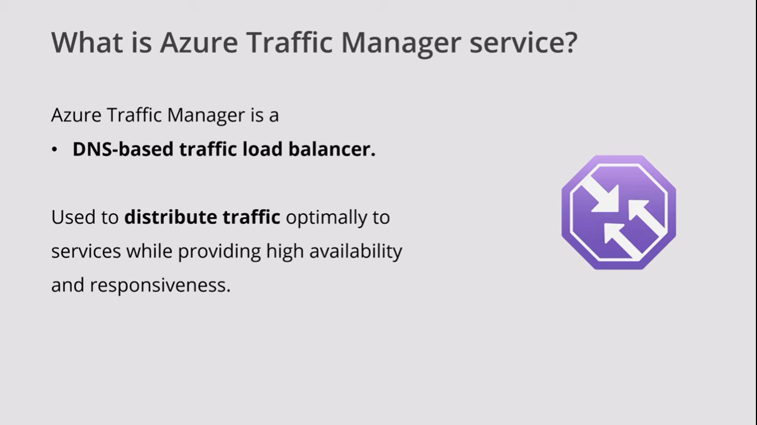

Slide 3
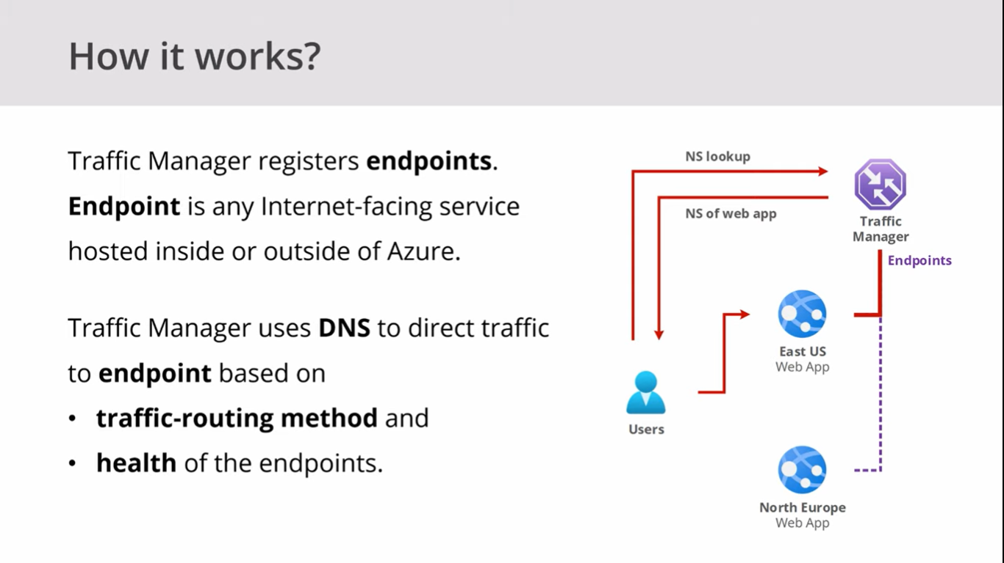

Slide 4
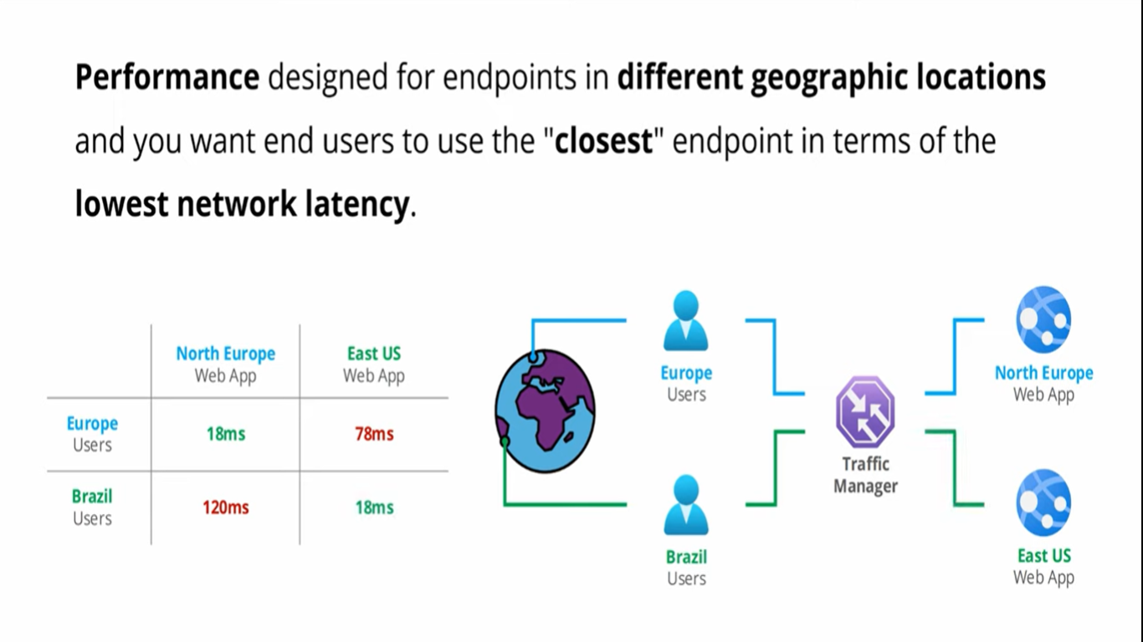

Slide 5
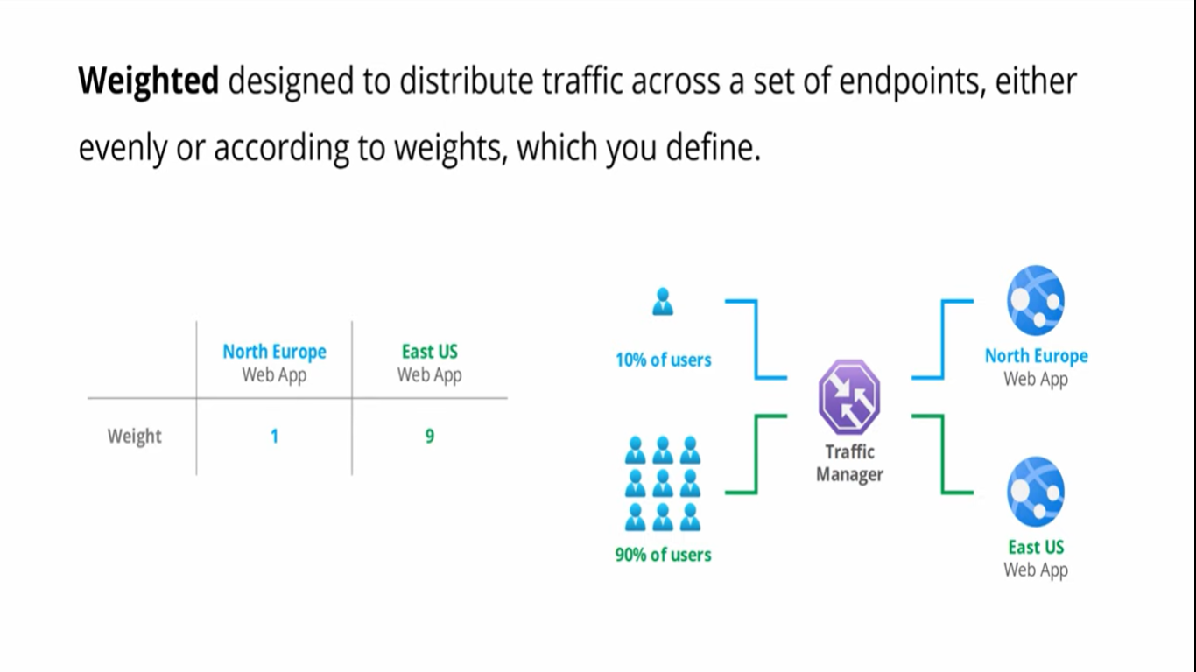

Slide 6
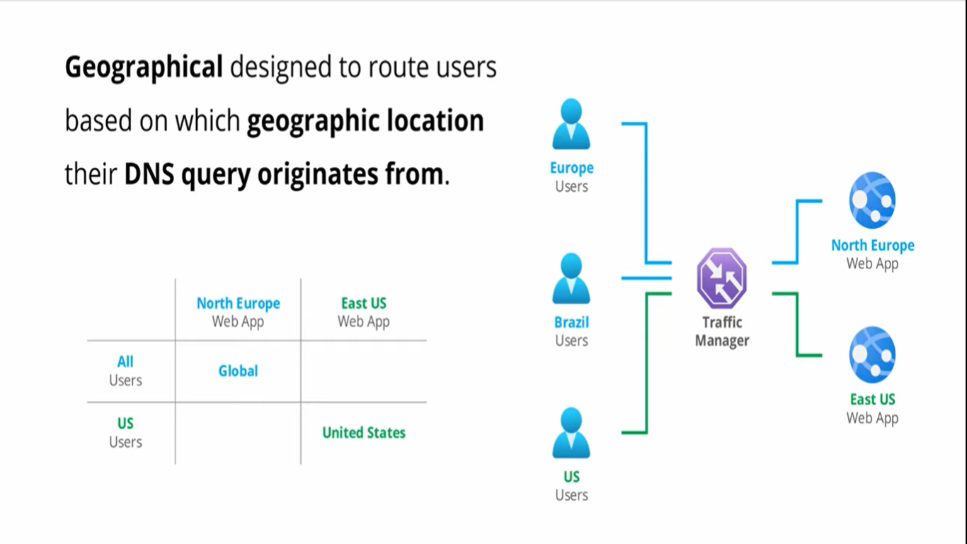

Slide 7
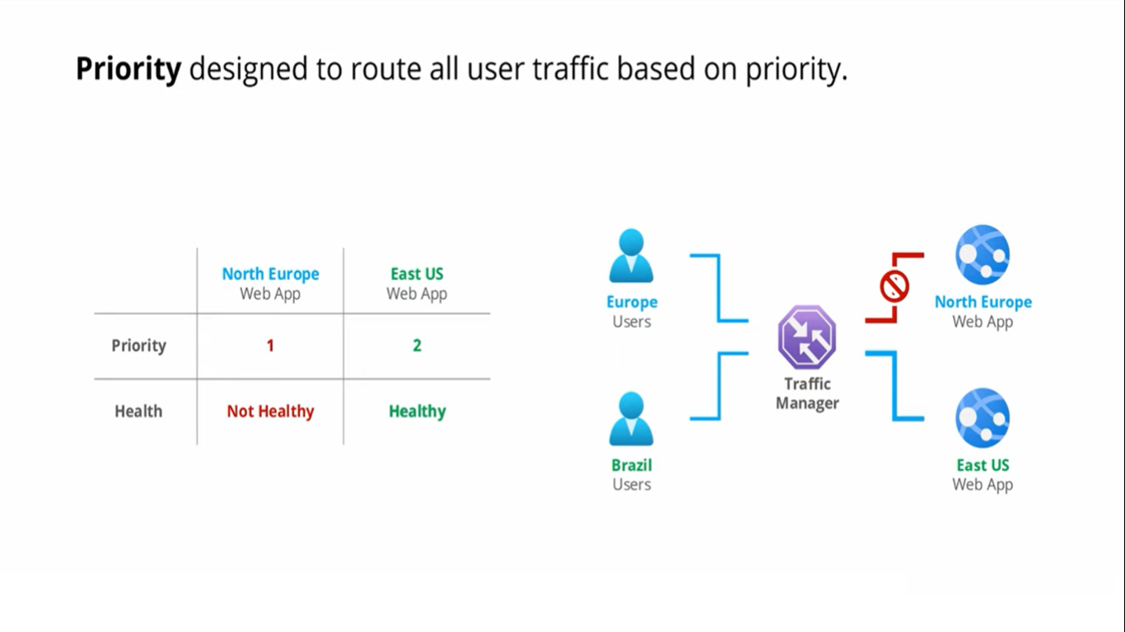

Slide 8
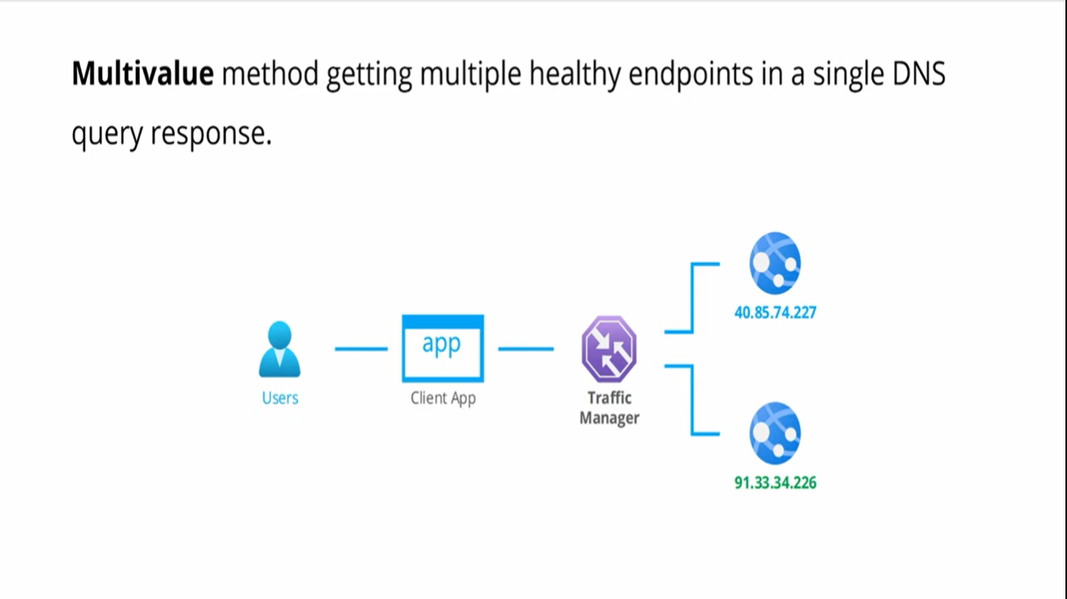

Slide 9
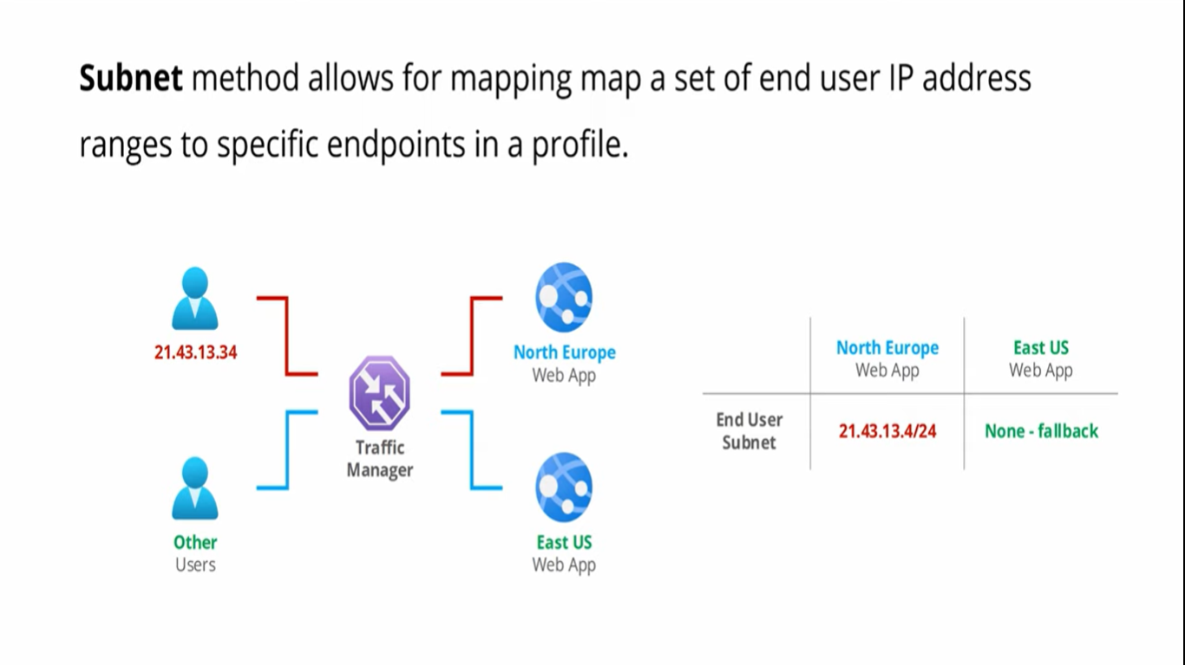

Slide 10
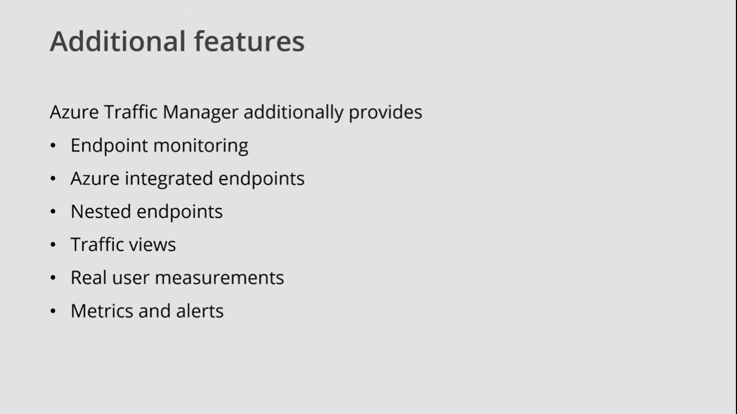

Slide 11
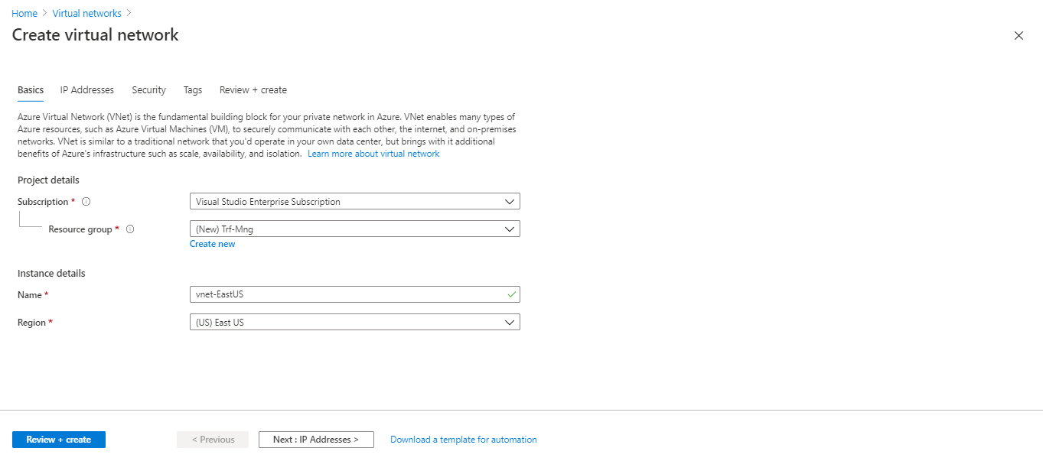
Creating First vnet in EastUS (1st Region).

Slide 12

Creating Second vnet in WestUS (2nd Region).

Slide 13
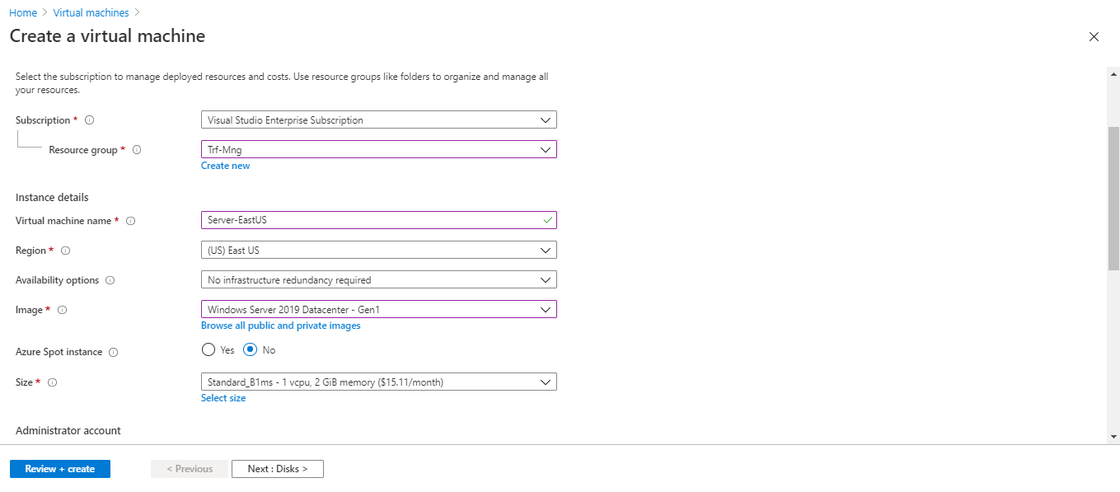
Creating First Server In EastUS

Slide 14
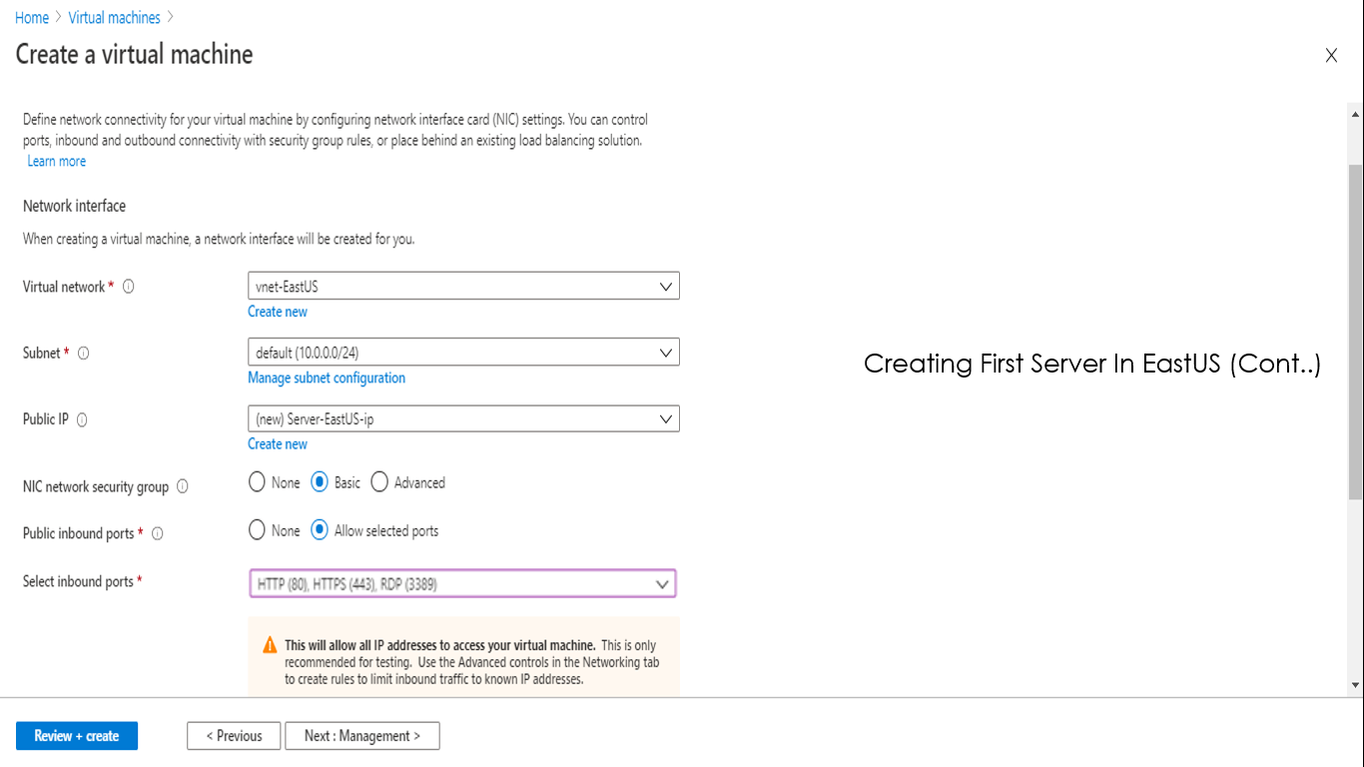
Creating First Server In EastUS (Cont..)

Slide 15
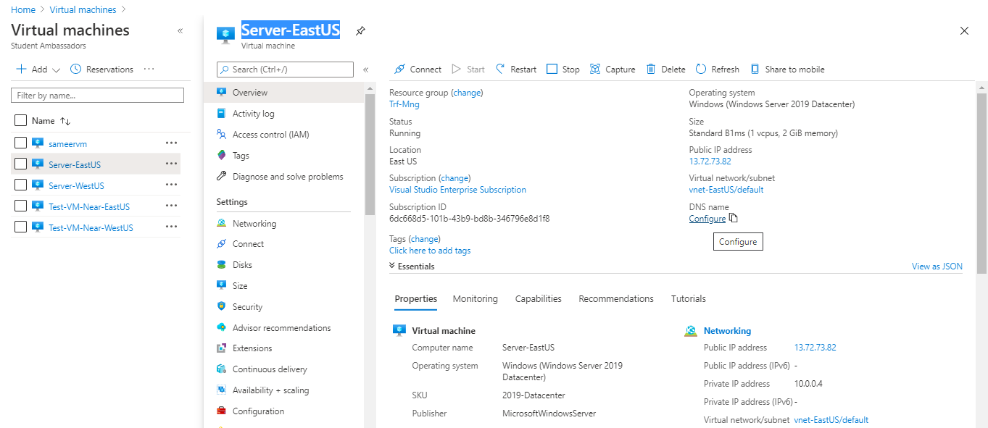
Configuring A DNS name for East-US server.

Slide 16
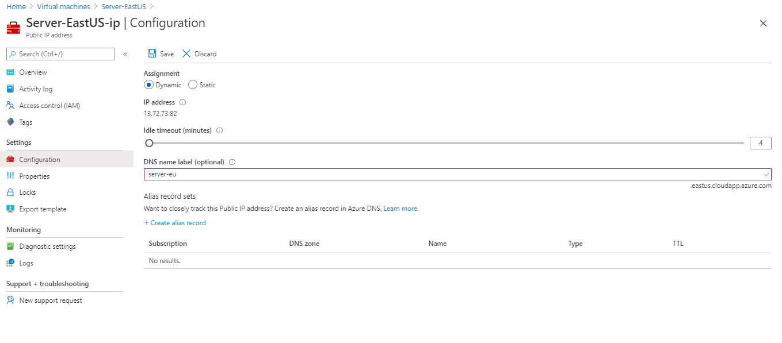

Slide 17
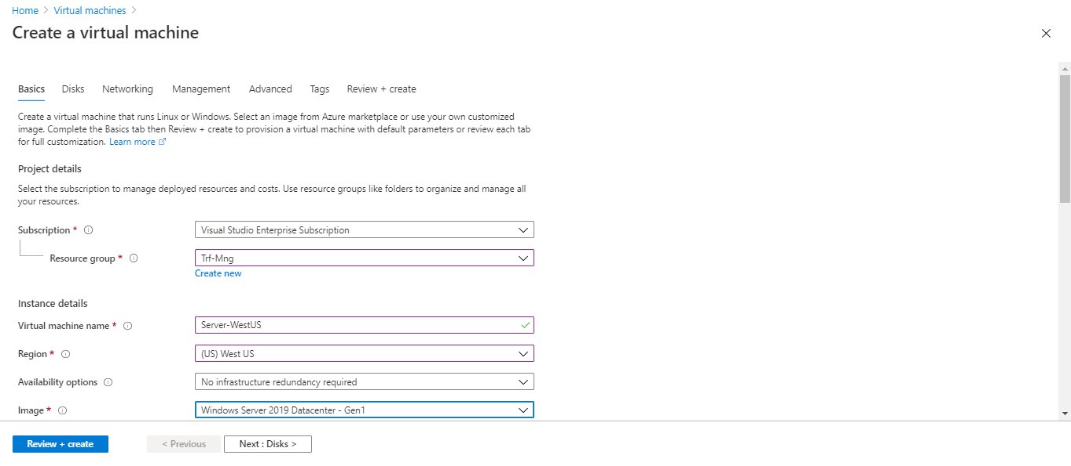
Creating Second Server In WestUS

Slide 18
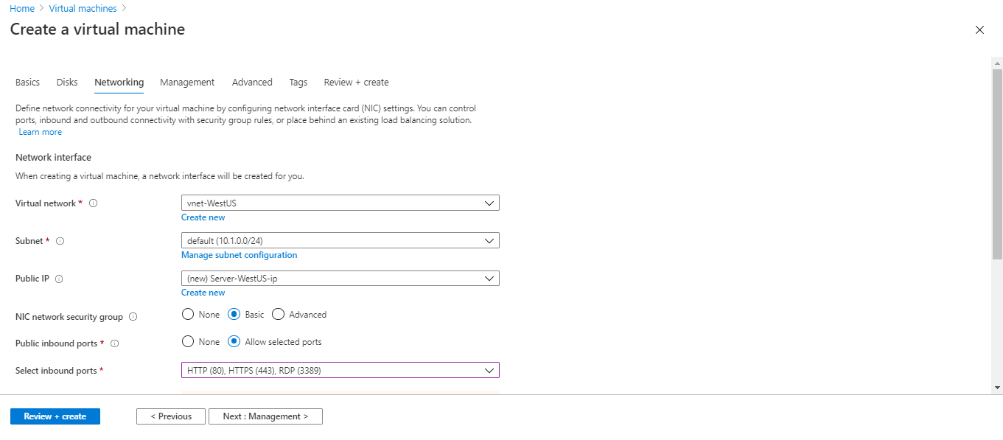
Creating Second Server In WestUS(Cont..)

Slide 19
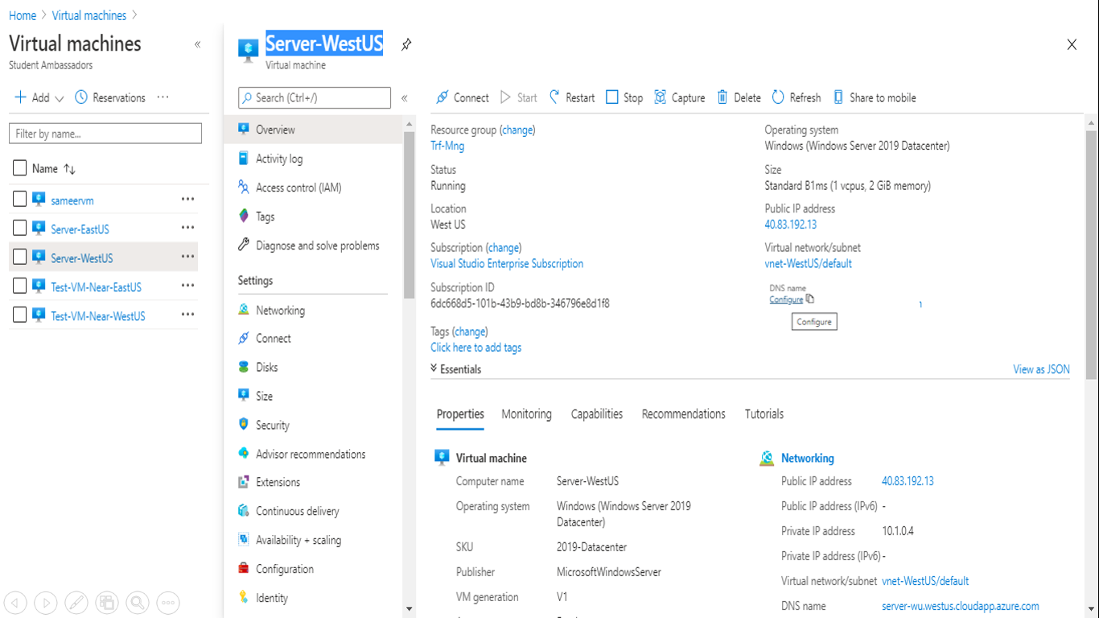

Slide 20
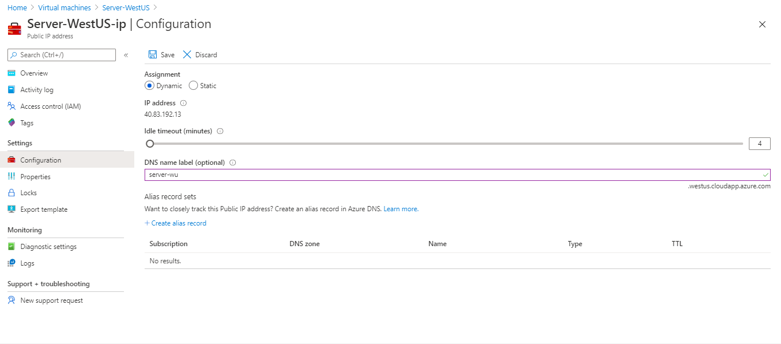

Slide 21
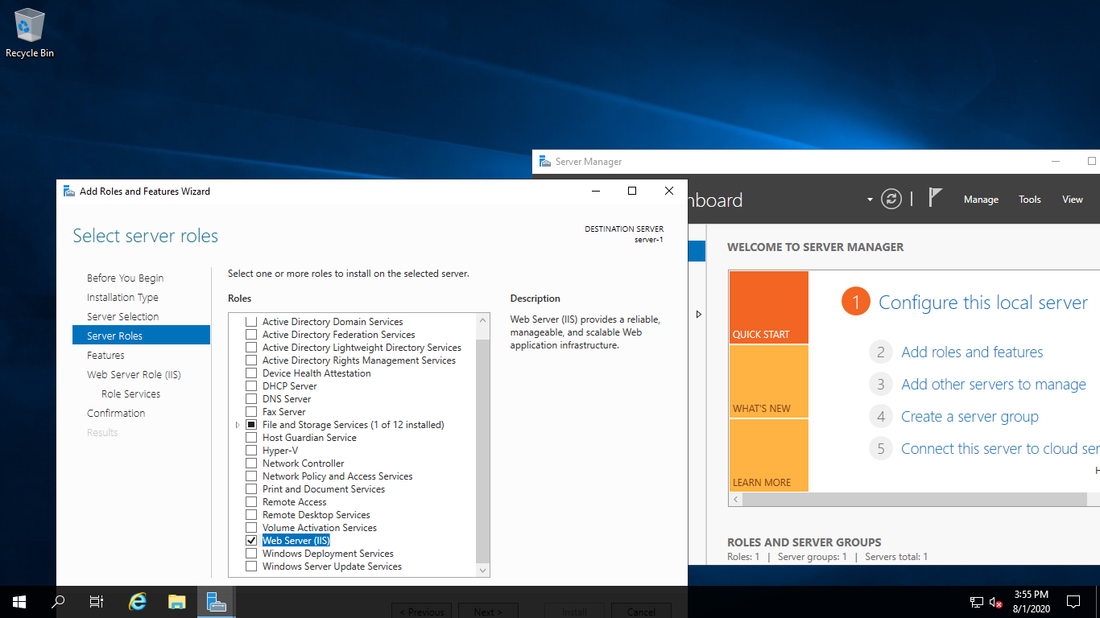
Install IIS Web Server In Both The Virtual Machines.

Slide 22
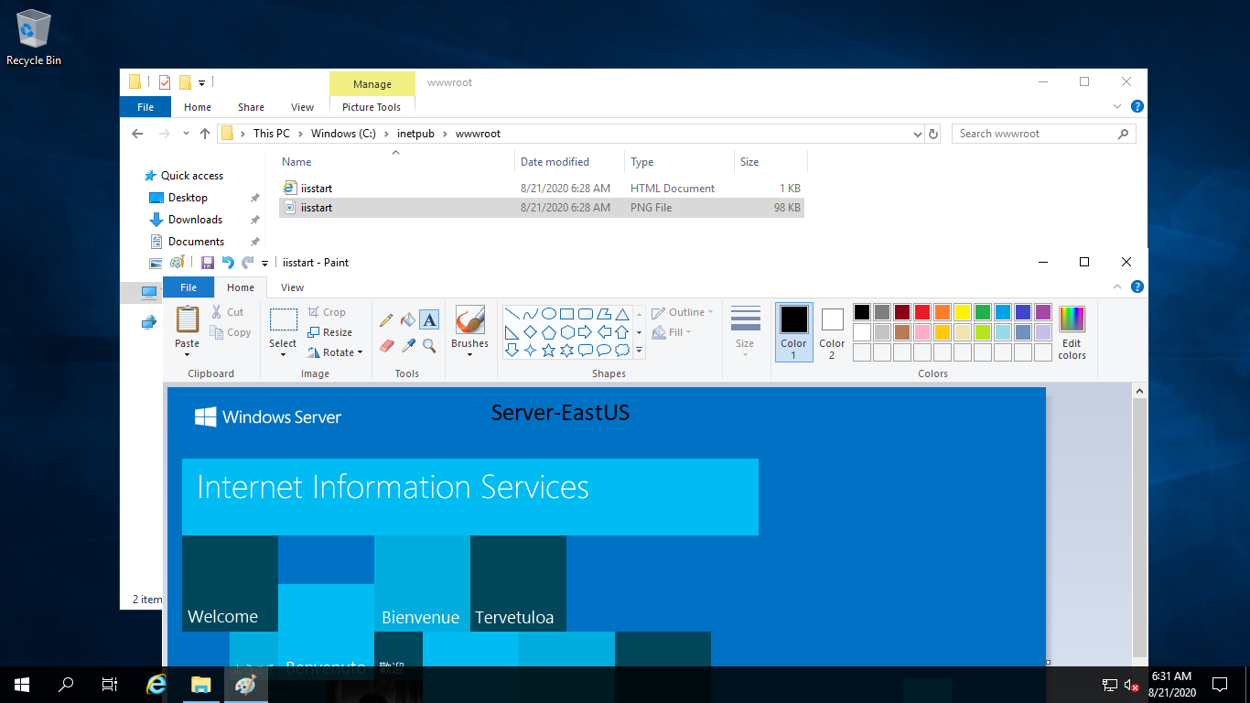
Edit The Server Image File In East-US Server.

Slide 23
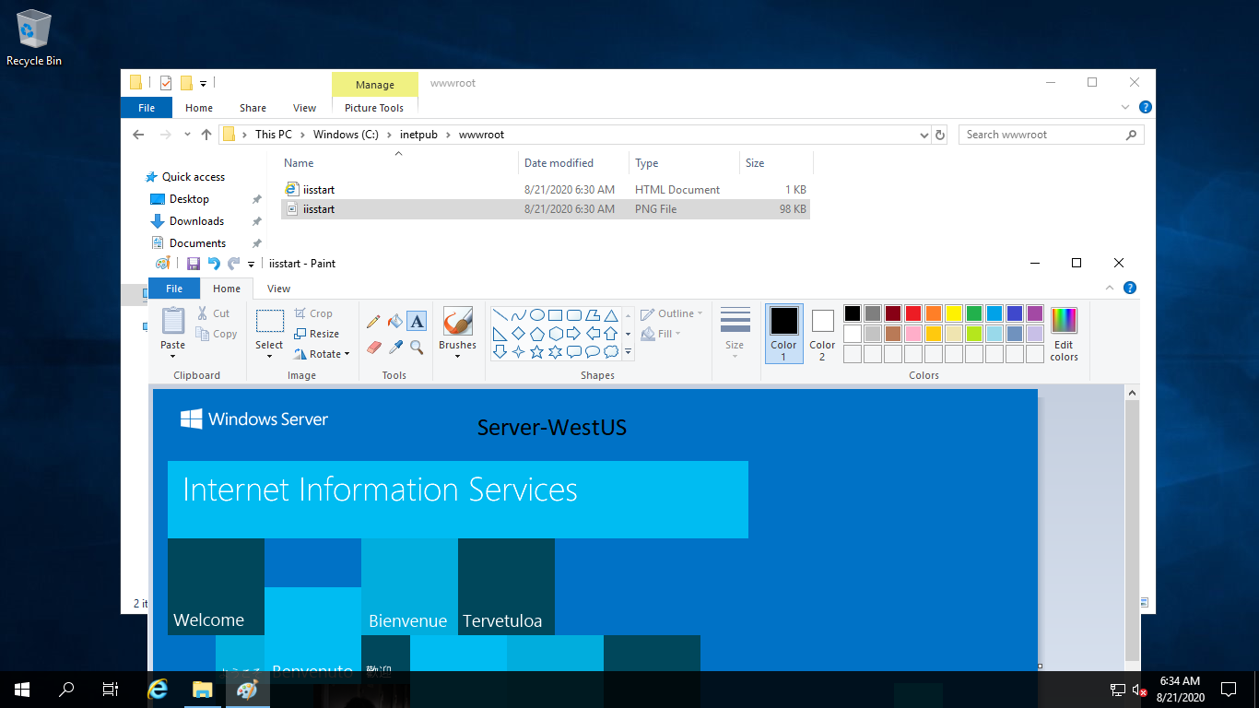
Edit The Server Image File In West-US Server.

Slide 24
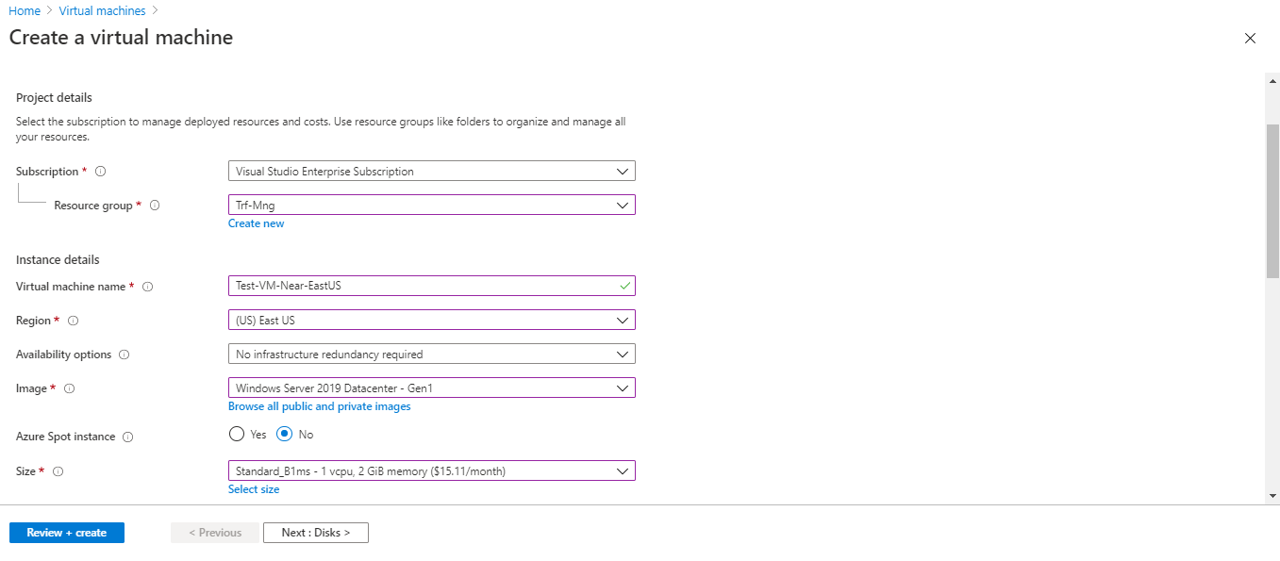
Creating A Testing Virtual Machine Inside EastUS Or Near To EastUS.

Slide 25
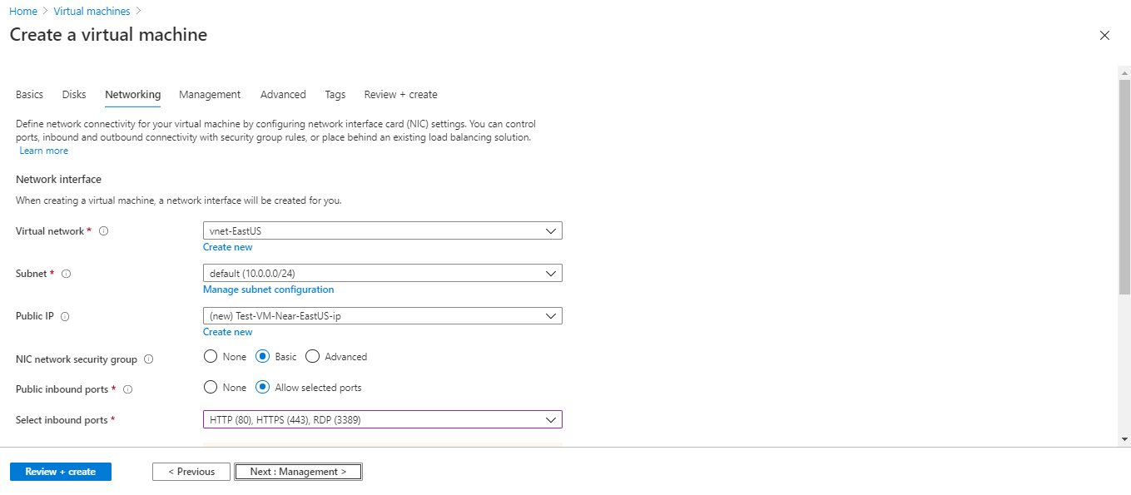
Creating A Testing Virtual Machine Inside EastUS Or Near To EastUS (Cont..).

Slide 26
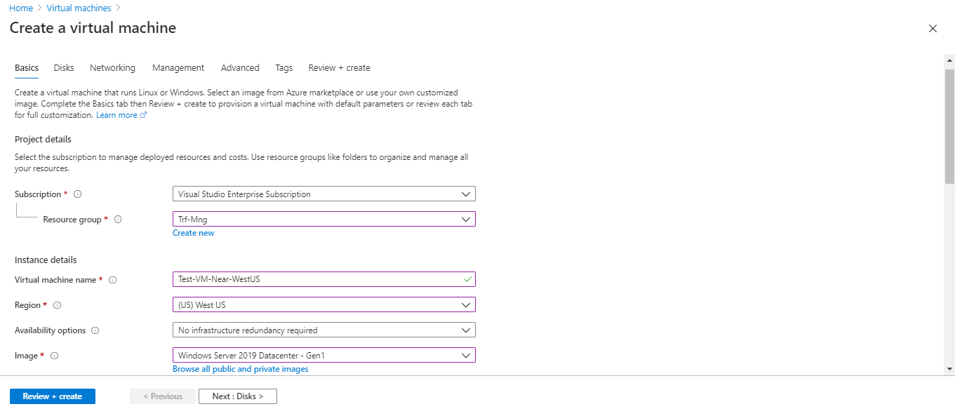
Creating A Testing Virtual Machine Inside WestUS Or Near To WestUS.

Slide 27
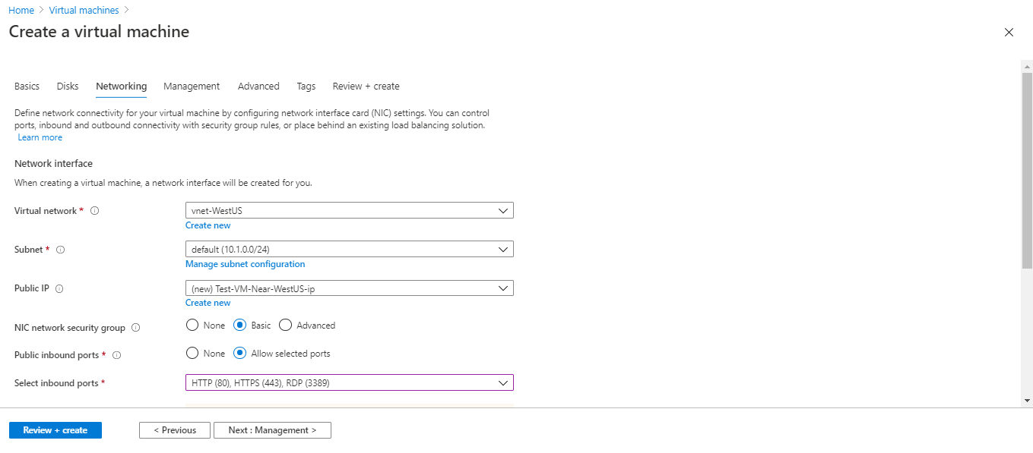
Creating A Testing Virtual Machine Inside WestUS Or Near To WestUS (Cont..).

Slide 29
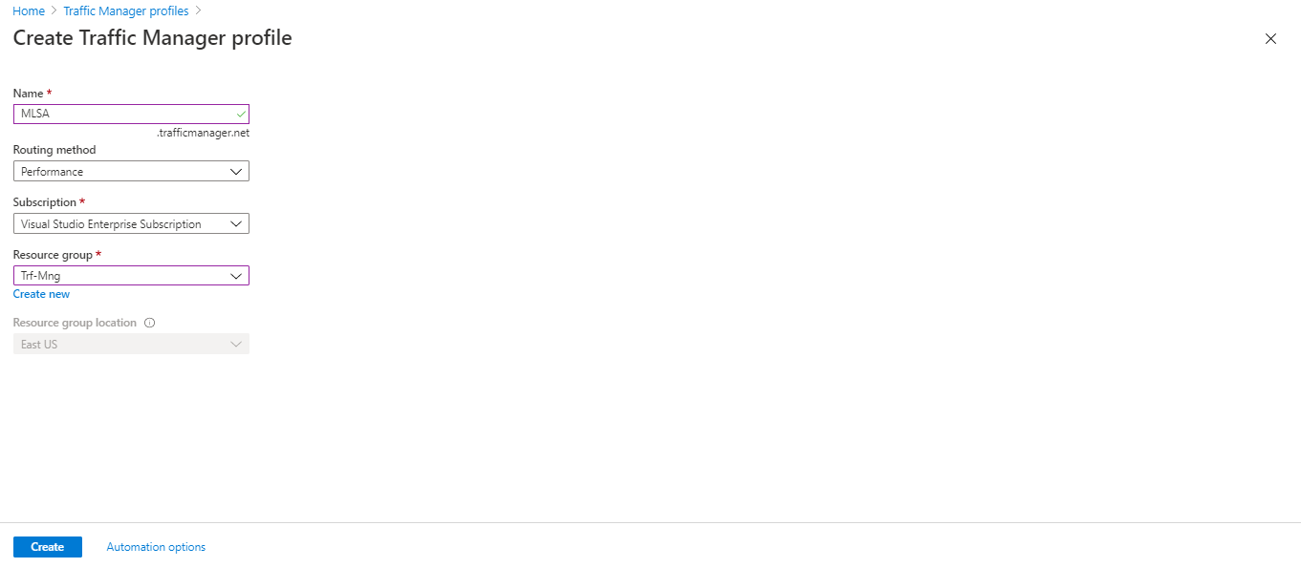

Slide 30
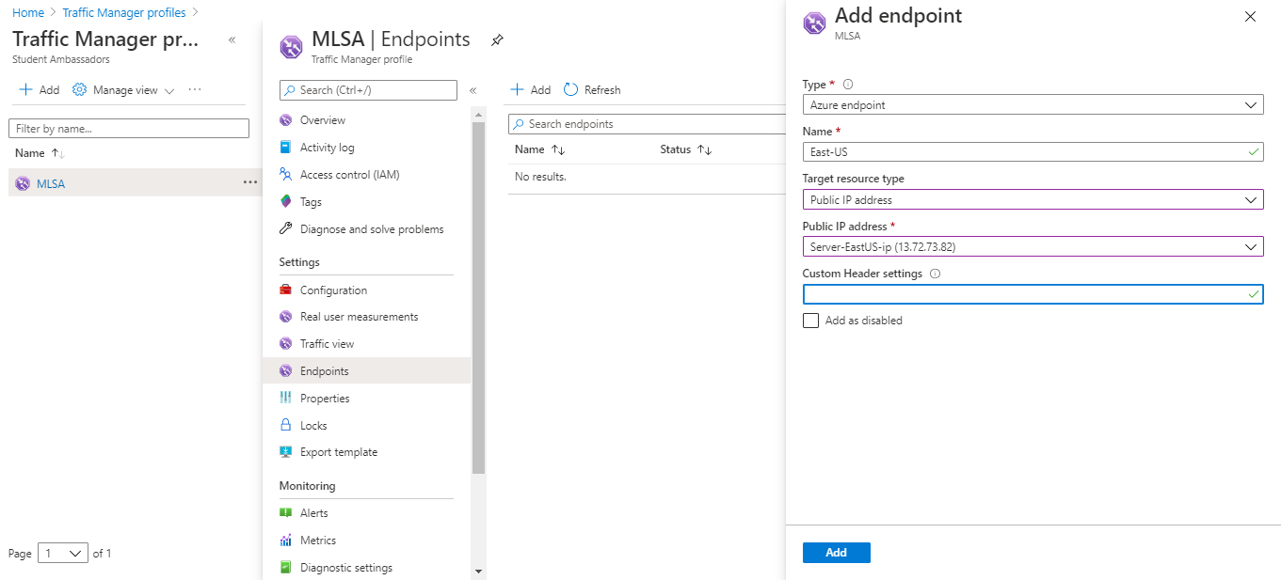

Slide 31
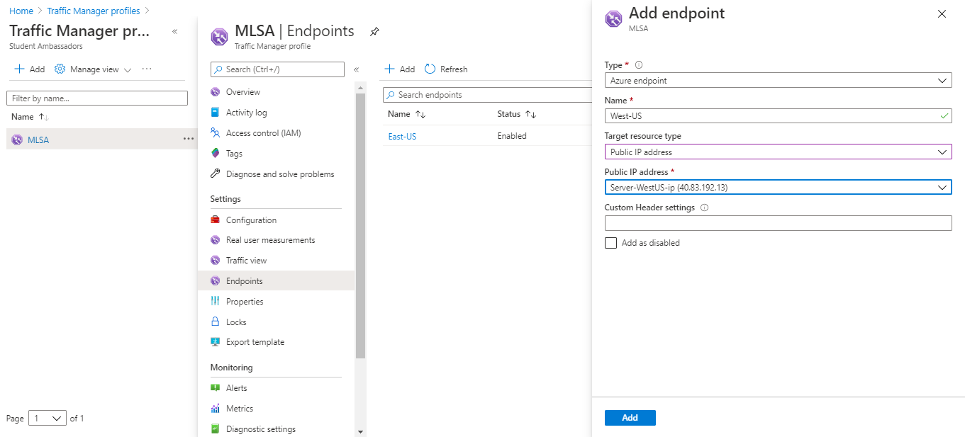

Slide 32
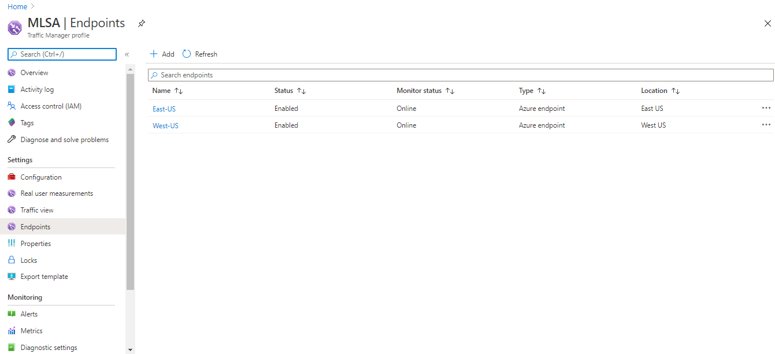

Slide 33
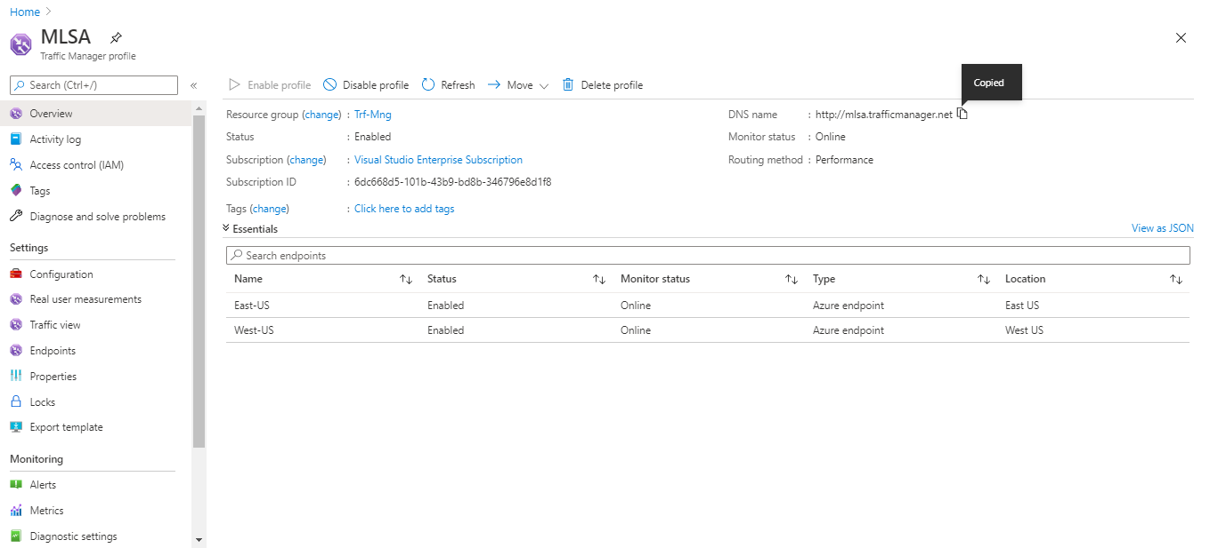

Slide 34
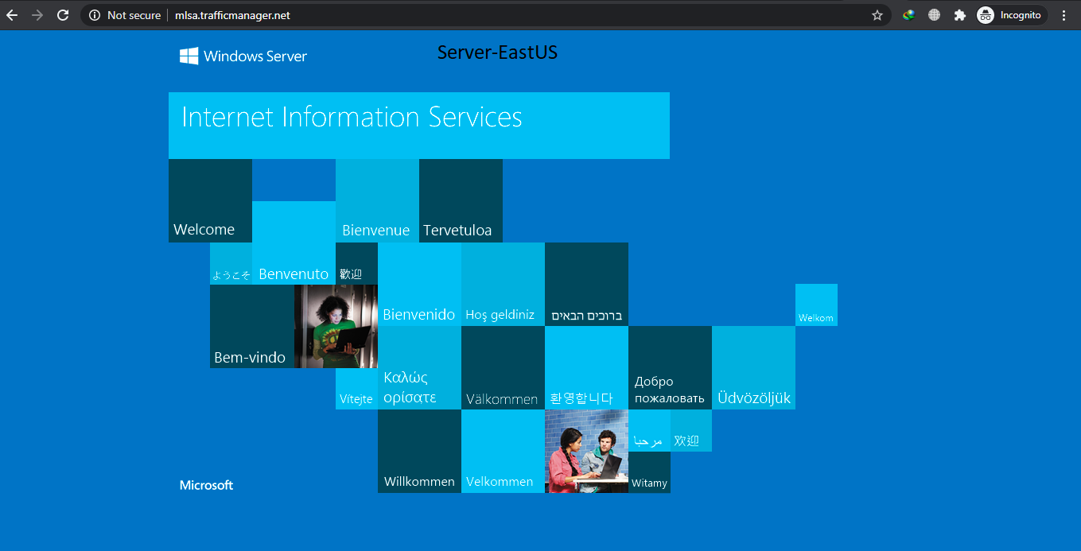
Visiting The Server From Personal Computer.

Slide 35
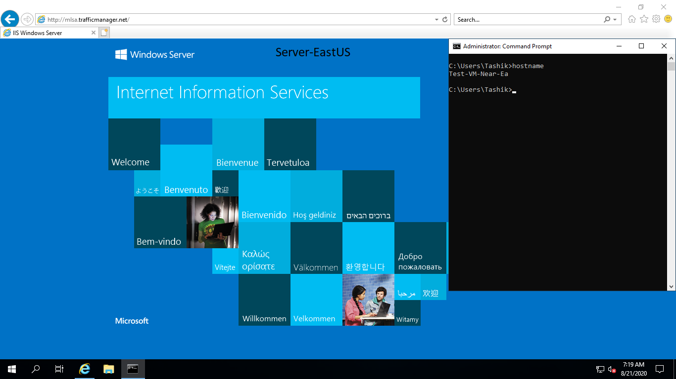
Visiting Server Page From Test VM Near Server EastUS

Slide 36
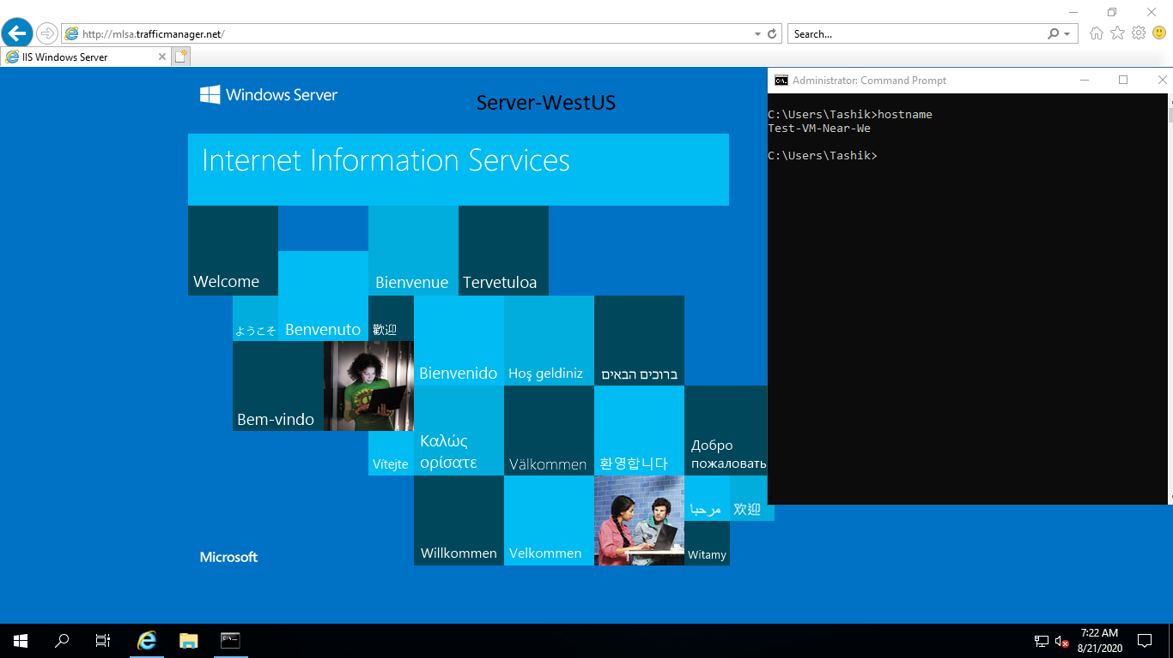
Visiting Server Page From Test VM Near Server WestUS

